Slide 1
Week 8

Slide 2
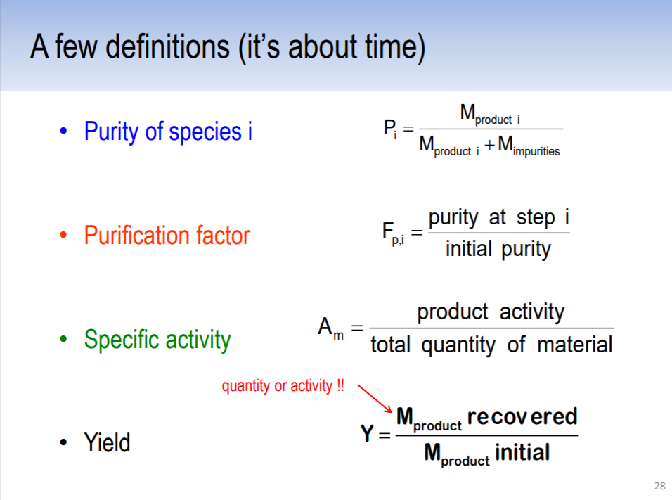
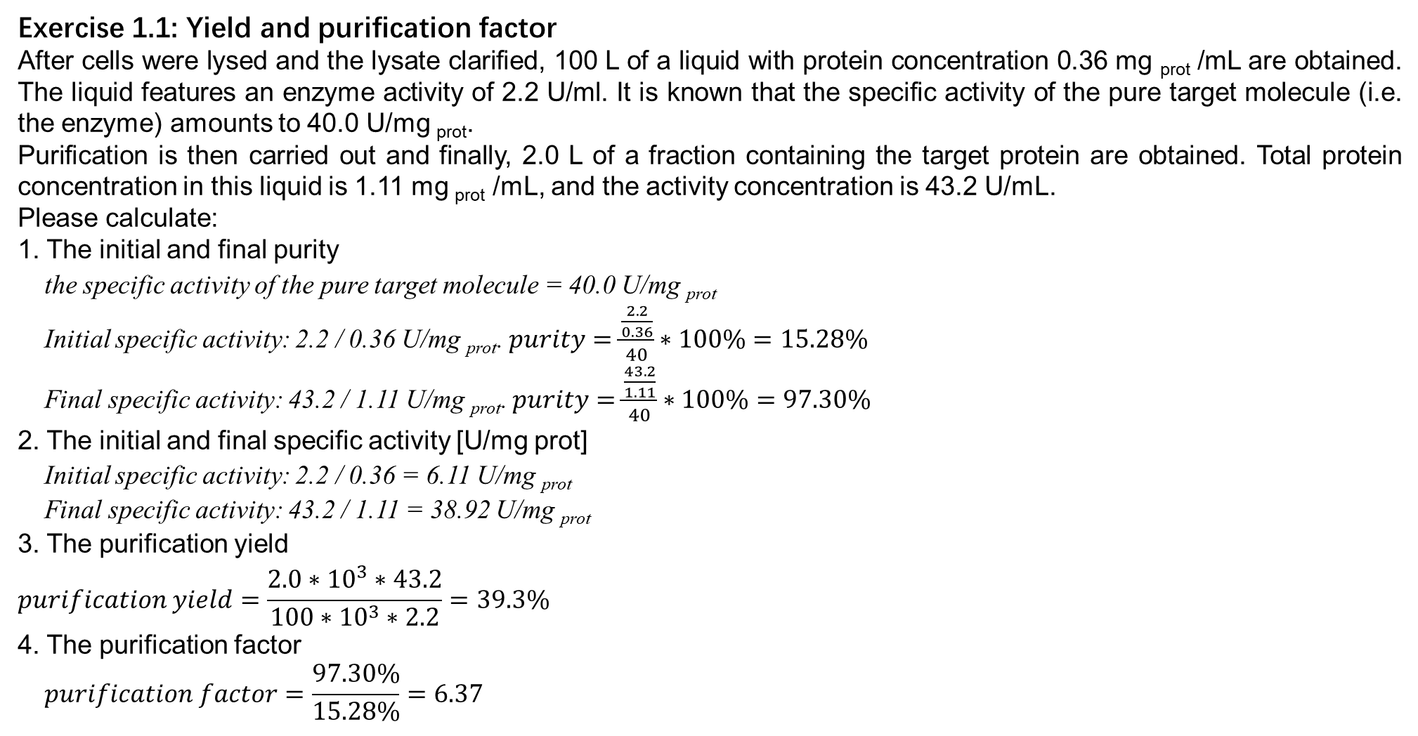
Exercise 1.1: Yield and purification factor
After cells were lysed and the lysate clarified, 100 L of a liquid with protein concentration 0.36 mg _{prot} /mL are obtained. The liquid features an enzyme activity of 2.2 U/ml. It is known that the specific activity of the pure target molecule (i.e. the enzyme) amounts to 40.0 U/mg _{prot}.
Purification is then carried out and finally, 2.0 L of a fraction containing the target protein are obtained. Total protein concentration in this liquid is 1.11 mg _{prot} /mL, and the activity concentration is 43.2 U/mL.
Please calculate:
1. The initial and final purity
the specific activity of the pure target molecule = 40.0 U/mg _{prot}
Initial specific activity: 2.2 / 0.36 U/mg _{prot}. $purity=\frac{\frac{2.2}{0.36}}{40}∗100\%=15.28\%$
Final specific activity: 43.2 / 1.11 U/mg _{prot}. $purity=\frac{\frac{43.2}{1.11}}{40}∗100\%=97.30\%$
2. The initial and final specific activity [U/mg prot]
Initial specific activity: 2.2 / 0.36 = 6.11 U/mg _{prot}
Final specific activity: 43.2 / 1.11 = 38.92 U/mg _{prot}
3. The purification yield
$$purification yield=\frac{2.0∗{10}^{3}∗43.2}{100∗{10}^{3}∗2.2}=39.3\%$$
4. The purification factor
$$purification factor=\frac{97.30\%}{15.28\%}=6.37$$

Slide 3
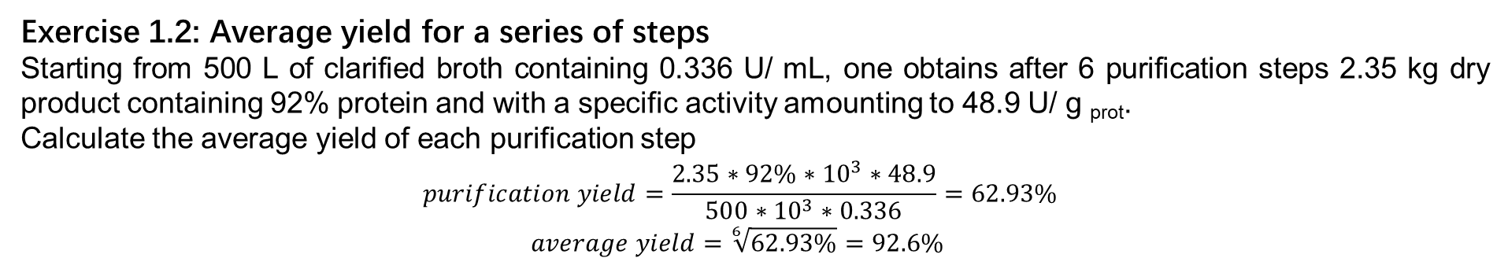
Exercise 1.2: Average yield for a series of steps
Starting from 500 L of clarified broth containing 0.336 U/ mL, one obtains after 6 purification steps 2.35 kg dry product containing 92% protein and with a specific activity amounting to 48.9 U/ g _{prot}.
Calculate the average yield of each purification step
$$purification yield=\frac{2.35∗92\%∗{10}^{3}∗48.9}{500∗{10}^{3}∗0.336}=62.93\%$$
$$average yield=\sqrt[6]{62.93\%}=92.6\%$$
Exercise 1.3: Isolation of an enzyme
The specific activity of an enzyme (expressed in U/ g _{prot)} has increased steadily over the first three steps of its purification before starting to decrease. The electrophoretic analyses however show that the amount of contaminants decreases continuously over the whole process. Further, the final fraction is almost completely devoid of contaminants and the protein can be considered pure.
1. What do you think happened?
The most likely explanation is that the enzyme, although purified, was denatured by the processing conditions in one or the other step. It therefore lost its biological activity while the mass yield remained unchanged.
Especially the third step.
2. What would you propose to reduce the loss of specific activity?
Identify the steps and conditions that are responsible for the greatest losses and look for alternative conditions / methods that better preserve the target molecule.

Slide 4
Exercise 1.4: Selection of a proper DSP sequence
As a development engineer you are asked to purify a recombinant enzyme from a culture of Escherichia coli at industrial scale.
Choosing from the list of techniques below, please select a logical sequence of 6 purification steps that will take you from the content of the bioreactor to a reasonably pure form of your enzyme (many possible answers). Draw the corresponding flow sheet.
NB: it may be worth mentioning that E. coli is usually not able to excrete the product into the surrounding medium. Also, certain methods can be used repeatedly.
Purification techniques: Ion-exchange chromatography, Sedimentation, Liquid-liquid extraction, Precipitation, Ultrafiltration, Bead mill, Refolding, Diafiltration, Crystallization, High pressure homogenization, Gel electrophoresis, Centrifugation, Size exclusion chromatography, Electrodialysis, Destillation, Absorption.
There are a multitude of valid answers to this question, however the steps must respect a logic associated with their characteristics of resolution, capacity, efficiency and speed. In addition, since E. coli does not secrete the product it is therefore intracellular and an additional cell lysis step and a liquid / solid separation step should be included in the process.
A possible answer could be:
1. Liquid / solid separation (centrifugation) and recovery of the solid fraction
2. Cell lysis (high pressure homogenizer)
3. Solid liquid separation (centrifugation) and recovery of the liquid phase
4. Concentration and fractionation by ultrafiltration
5. Ion exchange chromatography
6. Crystallization

Slide 5
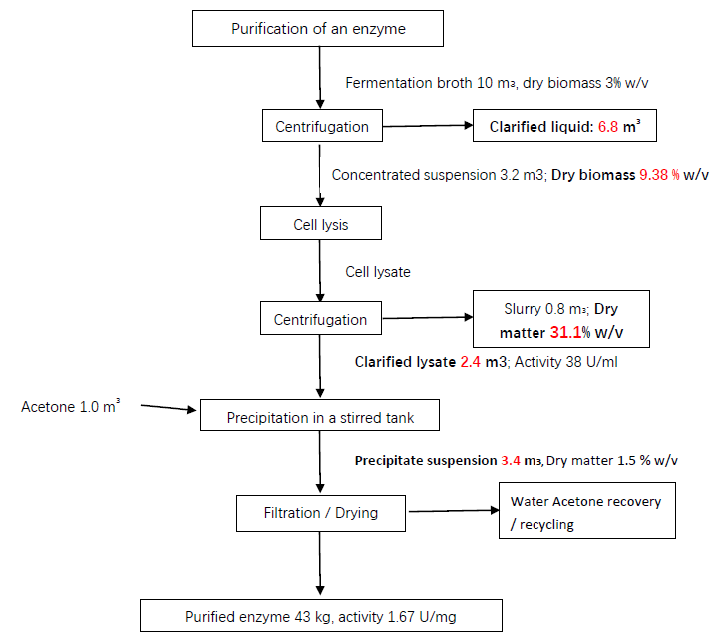
Exercise 1.5: Mass, volume and activity balances
Please complete the flowsheet that describes the purification steps of an industrial enzyme.
Taking into account mass and activity balances, determine the overall purification yield.
1. Complete the above flow chart using the information at hand
2. How many enzyme units are lost with the liquid fraction of the slurry after the centrifugation of the cell lysate?
0.8·10⁶ ml * 38 U /ml = 30.4 units
3. Which is the global recovery yield of enzymatic activity?
The ratio of the total enzyme activity recovered in the dried solid and the total enzyme activity in the clarified lysate gives (43·10⁶ mg * 1.67 U /mg) / (2.4·10⁶ ml * 38 U /ml) = 0.79 = 79 %.

Slide 6
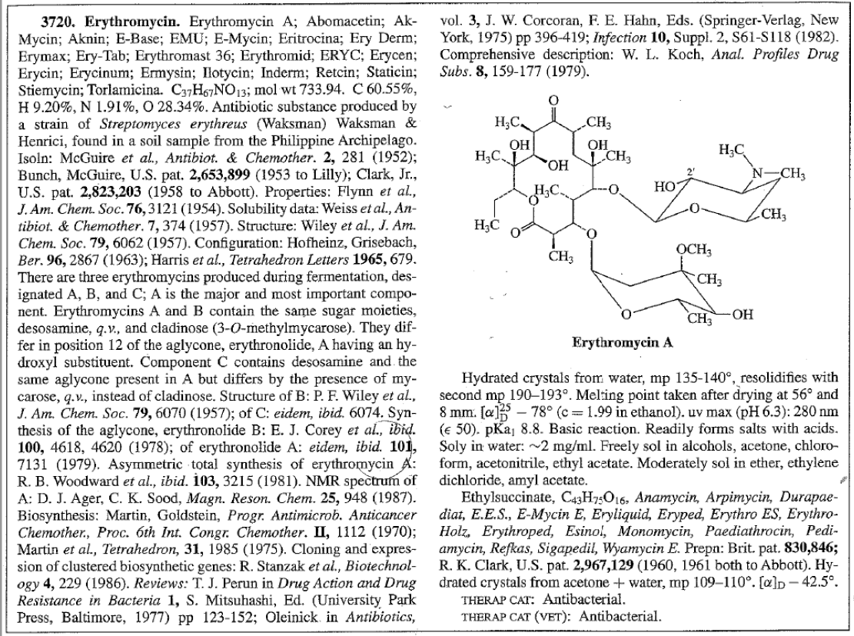
Exercise 1.6: Purification of erythromycin
You have been given the assignment to purify the antibiotic erythromycin. You have at your disposal the Merck Index, which has the information on erythromycin shown on the next page.
What do you think are the most likely unit operations that should could be used for the isolation and purification of this antibiotic?
the most relevant appears near the end of the section: it is said there that erythromycin has a rather low water solubility of 2 g/L, whereas it is readily soluble in organic solvents such as ethanol, acetone or acetonitrile. However, these solvents are water-miscible in about all proportions and would not be much help in terms of purification.
In this respect, chloroform or – even better since it is less toxic - ethyl acetate appear to be very interesting candidates for a liquid-liquid extraction step performed directly from the fermentation broth. Depending on the partition coefficient of the antibiotic in the organic phase, this could lead to a significant concentration of the product, together with the removal of many contaminants that would remain in the aqueous phase.

Slide 7

How are PLLA and PLGA produced?
What are the principal uses and applications of lactic acid?
cosmetic industry
food additive
pharmaceutical technology to produce water-soluble lactates from otherwise-insoluble active ingredients
Lactic acid is also the monomer for the production of biodegradable polymers (PLA and PLGA)
For the anecdote, lactic acid has historically been used to assist with the erasure of inks from official papers to be modified during forgery.
In which ways is it commonly produced and purified
Biosynthesis and chemical synthesis
Extraction and exchange
What are these compounds used for?
Their polymers are biodegradable, used as materials for packaging and labeling, and biocompatible, being useful for the manufacture of prosthetic devices, sutures and internal drug dosing. Among them, the polylactic acid has several applications in the textile, medical and pharmaceutical industries.

